Slide 1


Entering Receipts
*Subject to change (version 2.0)
Office of Accounts Payable
1424 Boylan Hall
Ext. x5421

Slide 2
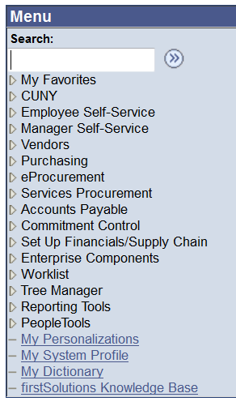
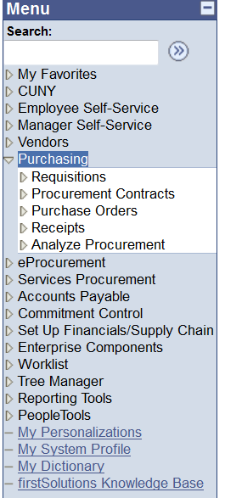
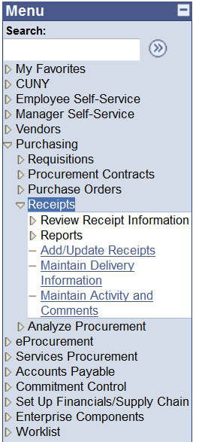
Click on Purchasing > Receipts > Add/Update Receipts

Slide 3
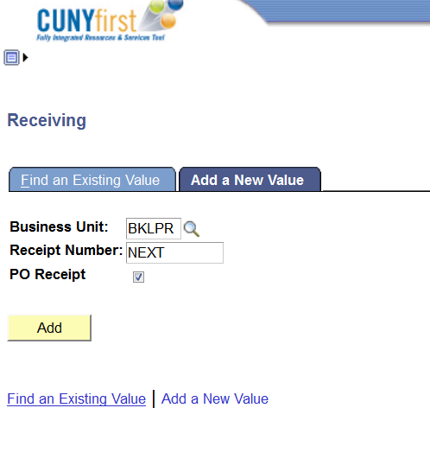
Click on Add button

Slide 4
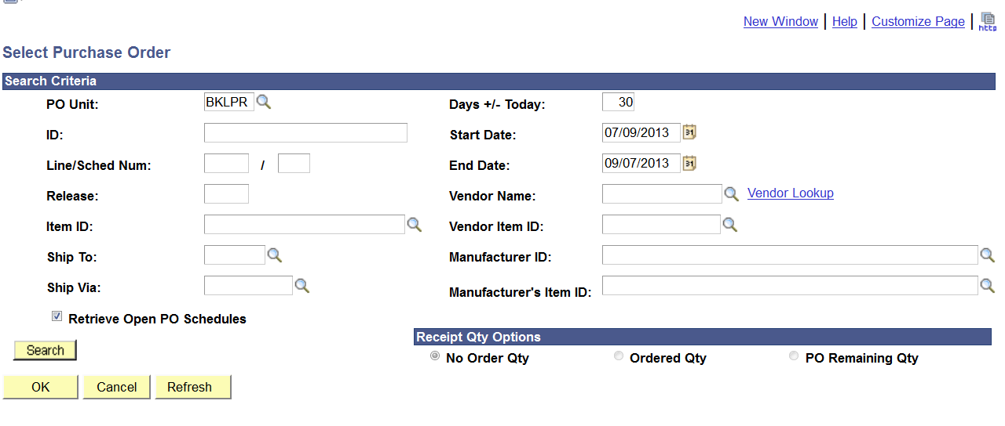
Find your PO# (not REQ #)
Type in your 10 digit PO #

Slide 5
Find your PO# (not REQ #)
Click on Search Button

Slide 6
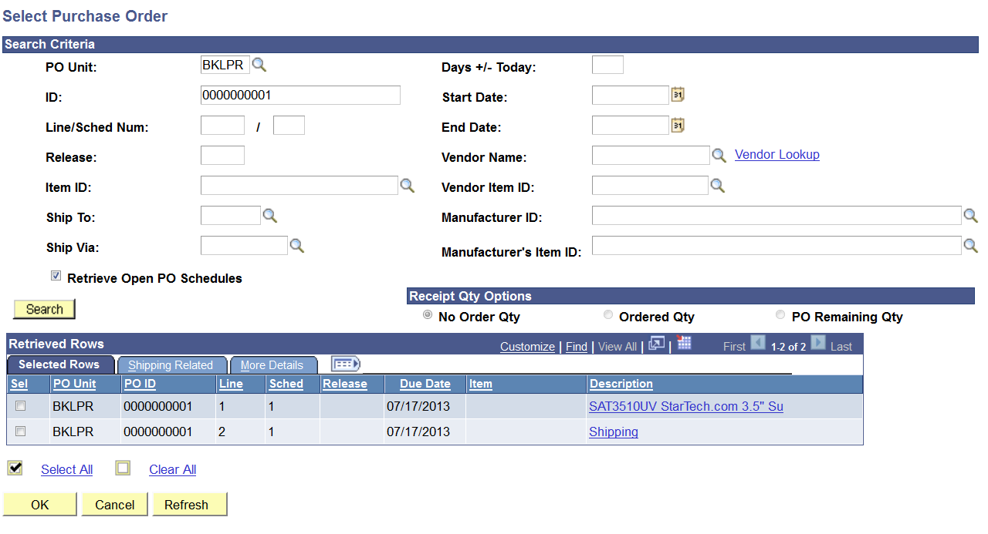
Click on the selected PO line(s) that you want to pay

Slide 7
Click on “OK” button

Slide 8
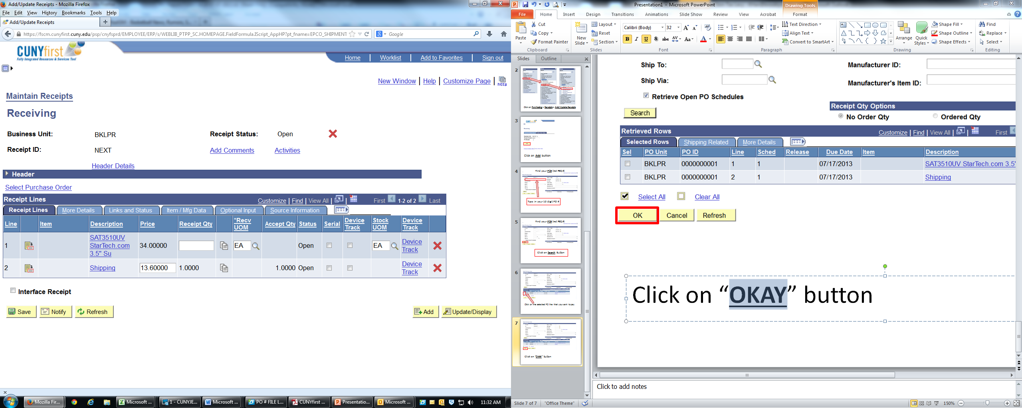
1.) Enter Quantity amount of order you have received
and/or
2.) Enter Amount that you have received

Slide 9
Click on “SAVE” button

Slide 10
NOTE: Once you click on “save” button, it generates a receipt number

Slide 11
Click on “ADD COMMENTS” link

Slide 12
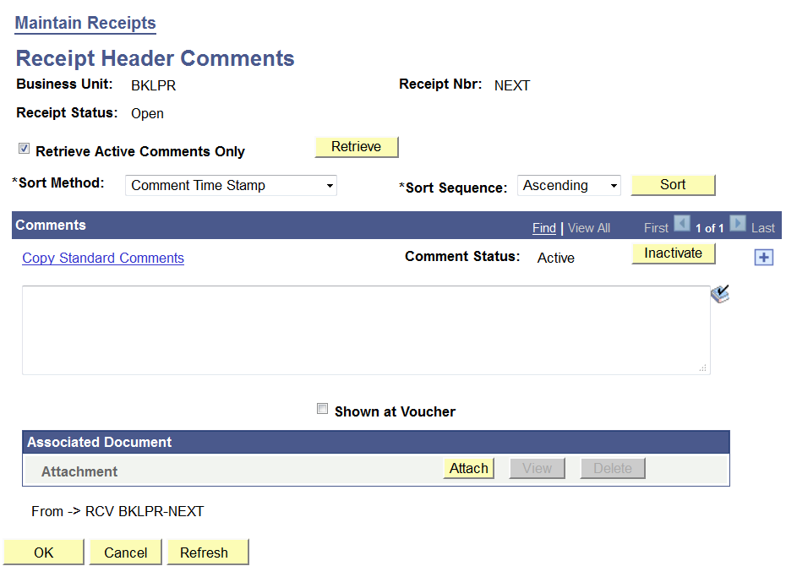
In the comments textbox, enter receipt information or any notes that Accounts Payable needs to know

Slide 13
Click “Shown at Voucher”

Slide 14
Click on “Attach”

Slide 15
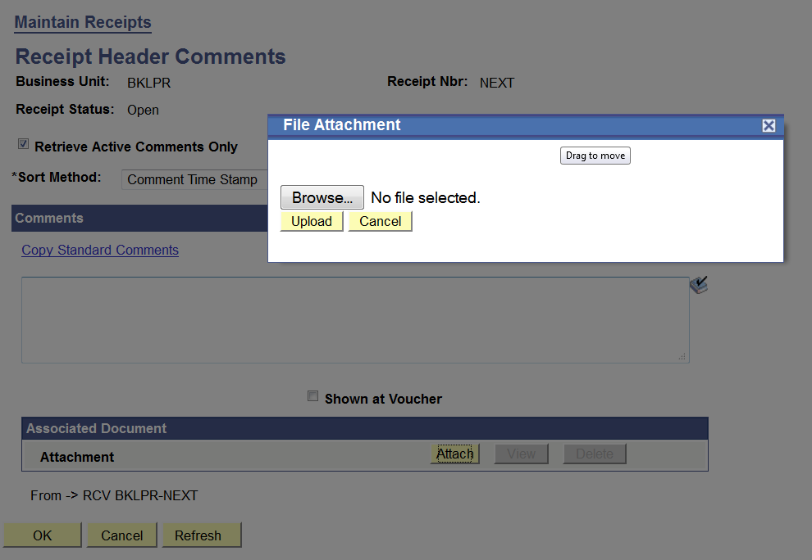
Click Browse and find the file you want to upload
Click on Upload

Slide 16
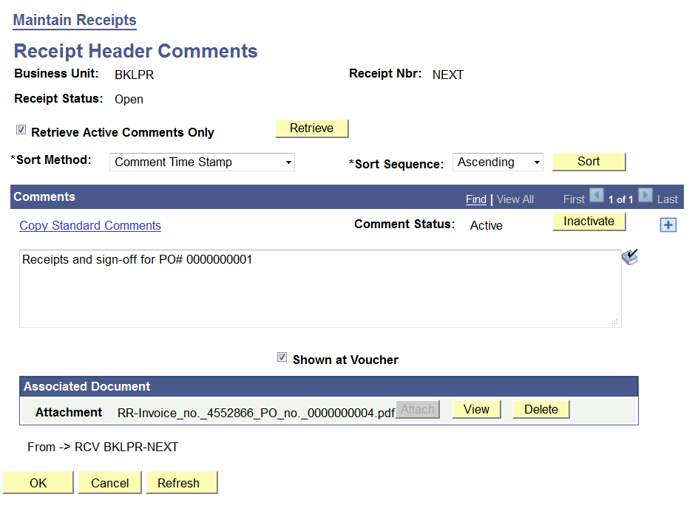
Comment box about receipt and other information
Shown at Voucher is checked
Attachment has been uploaded

Slide 17
Click “OK” button

Slide 18
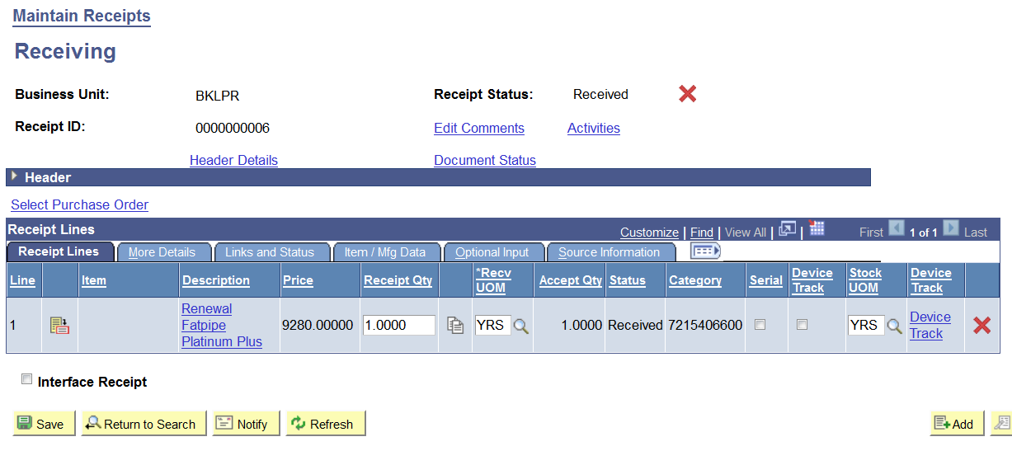
Check if receipt ID # has been created
Check if receipt status says “received”

Slide 19
Click on “Save” again

Slide 20
Click on “Header Details”

Slide 21
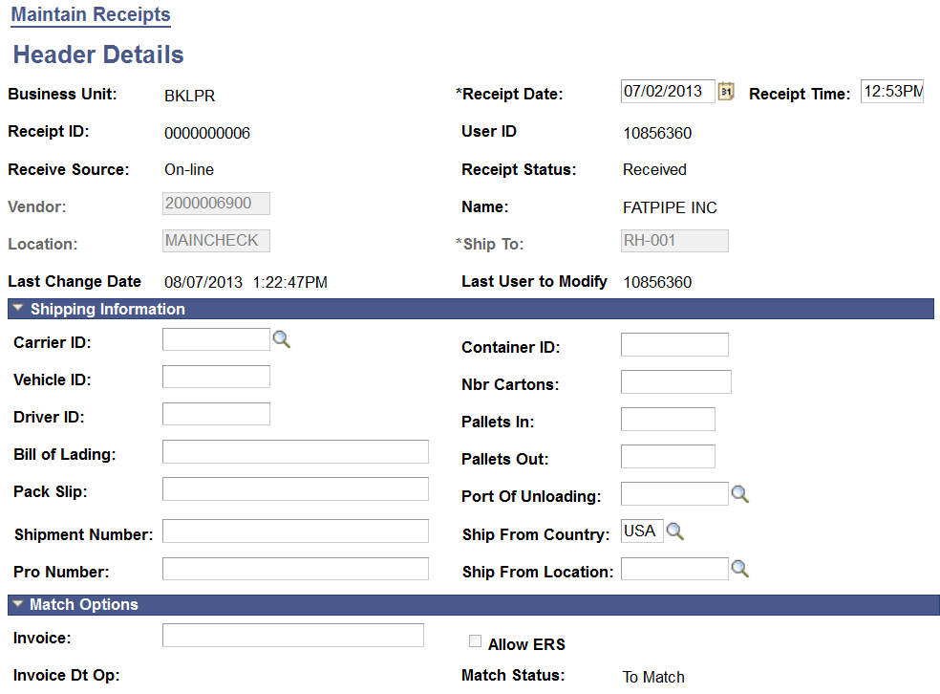
Enter Receipt Date – please go to the next 2 slides to enter the correct receipt date

Slide 22
Receipt Date
TYPE OF PURCHASES | GOODS RECEIPT DATE | EXAMPLE
ITEMS (PHYSICAL ITEMS)* | The date you have received the items | OFFICE SUPPLIES; COMPUTERS
SERVICES/LABORS* | The date defaults on the date of the service. If it is multiple dates, enter the LATEST DATE.
MONTHLY MAINTENANCE | The last date of the month.
HONORARIA | The date of the event occurred or last date of service. (If multiple days)
CATERING/FOOD | The date of the event.
WARRANTY | The first date of the warranty
*Please note: If the invoice is for BOTH service(s) and item(s), the service/labor date supersedes the items date.

Slide 23
Receipt Date
The signature and date for sign-off MUST MATCH the receipt date
Accounts Payable CANNOT pay if the two dates do not match

Slide 24
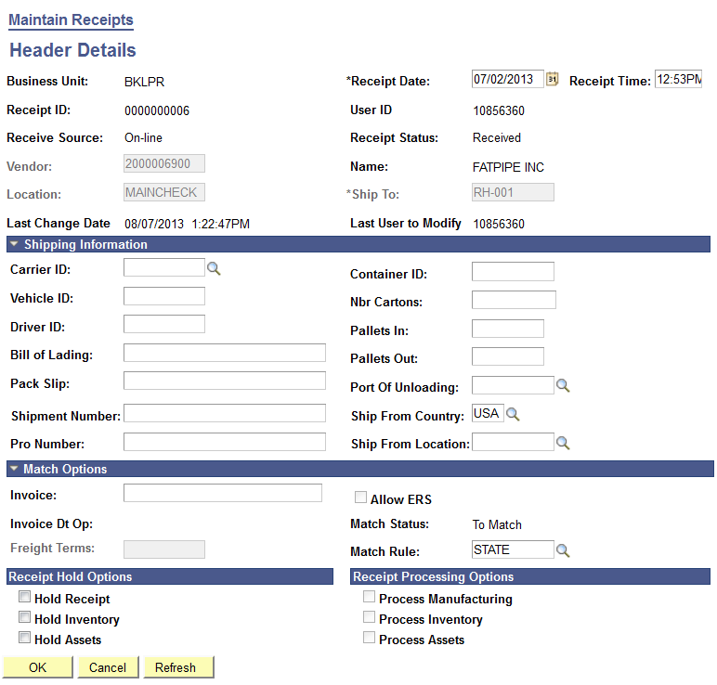
Click “OK” button

Slide 25
Click on “Save” again
NOTE: You will see a pop up screen – please hit “OK”

Slide 26
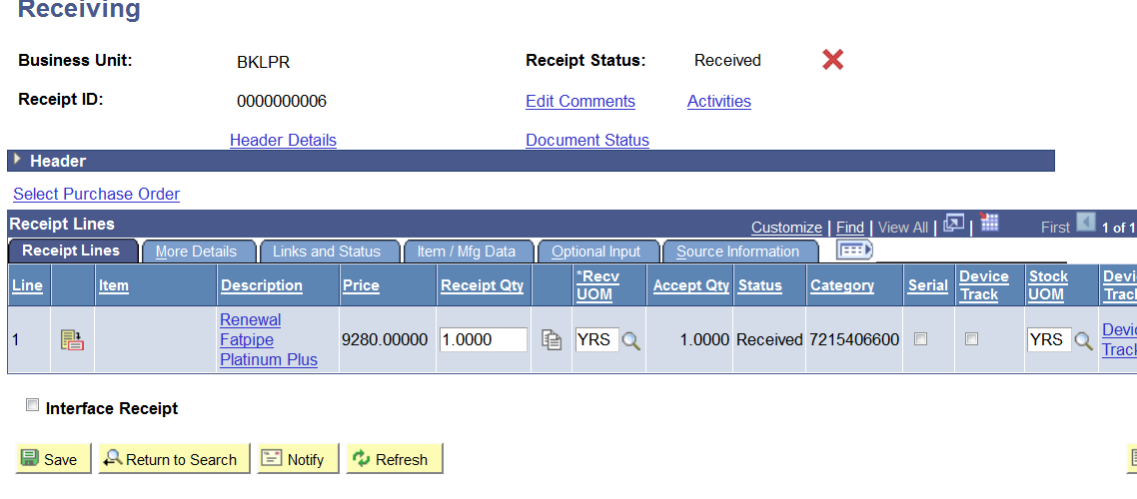
Click on the Icon

Slide 27
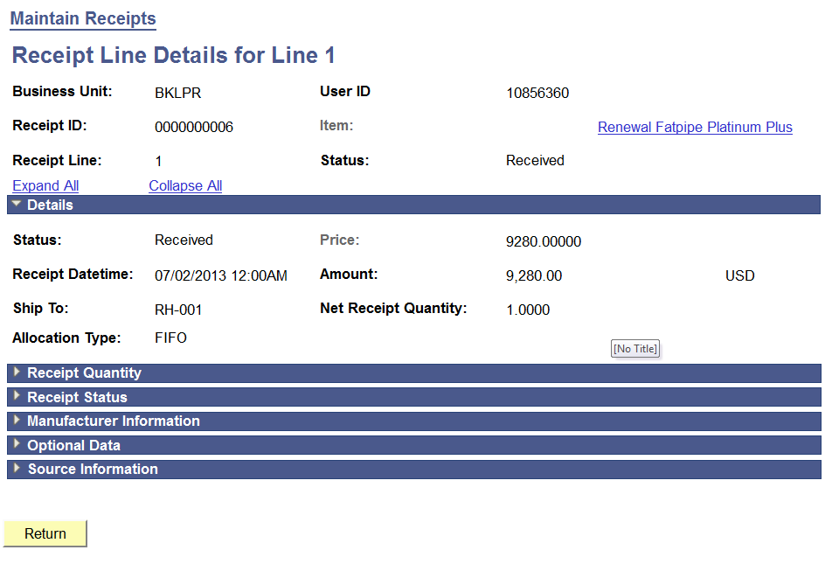
Make sure RECEIPT DATE TIME is correct

Slide 28
Print 2 copies, for your records AND for Accounts Payable

Slide 29
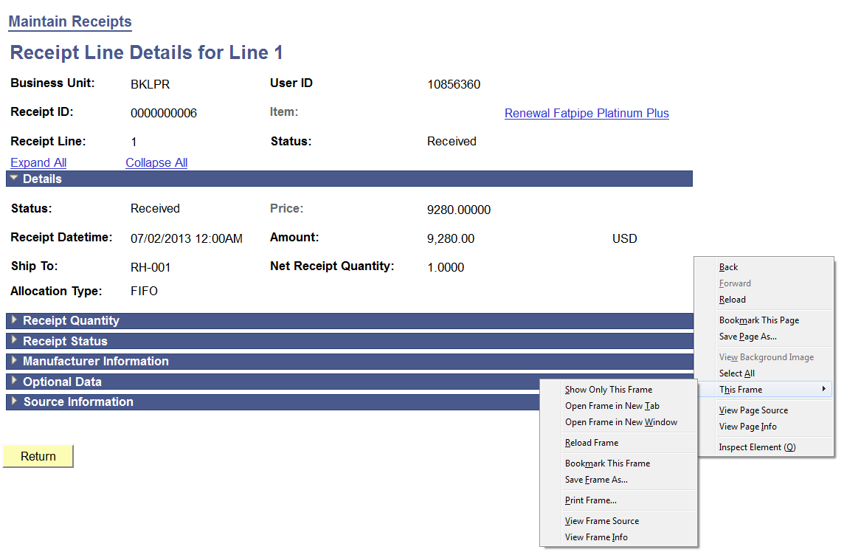
For FIREFOX, right click on mouse > this frame > print this frame and then left click

Slide 30
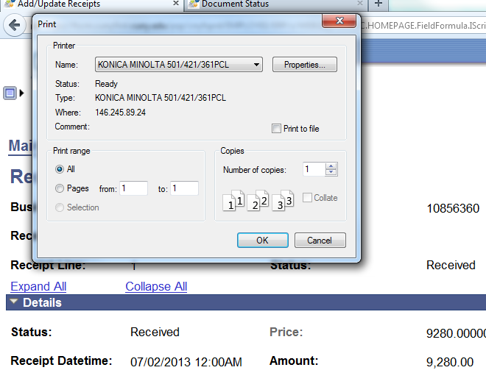
Click on okay to print.

Slide 31
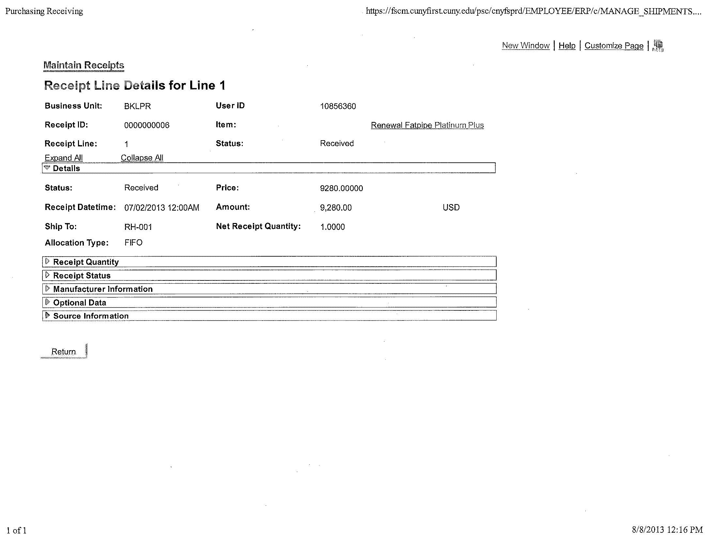
This is what it should look like
This will be your cover page

Slide 32
What do you need to give to A/P to pay
1.) Cover Page
2.) Packing Slips
3.) Sign-off (on packing slips/invoices/etc)
4.) Invoices, must have correct PO # (if any)
We will not pay without the hard copies!!!!

Slide 33
If there’s any questions please call
Accounts Payable
(718) 951-5421

