Slide 1
Evaluating Academic Support Services Programs
Michael J. Anderson, PhD
CUNY Academic Support Services Forum
March 15, 2012
CUNY Graduate Center
Some slides/content by Mosen Auryan, PhD
CUNY Assessment
Council
Notes:
Thanks to City Tech (Dr. Ashley Ater Kranov), Assessment Council, Niesha, Sharona Levy, etc.
Definition of Evaluation v. Assessment
Program Evaluation is: Systematic collection, analysis and reporting of descriptive and judgmental information about the merit and worth of a program ‘s design, process and outcomes, to address improvement, accountability, and dissemination questions and increase understanding of the involved phenomena. Stufflebeam and Shinkfield, Evaluation Theory, Models, and Applications, (2007)

Slide 2
Program Evaluation is: Systematic collection, analysis and reporting of descriptive and judgmental information about the merit and worth of a program’s design, process and outcomes, to address improvement, accountability, and dissemination questions and increase understanding of the involved phenomena.
Stufflebeam and Shinkfield, Evaluation Theory, Models, and Applications, (2007).
CUNY Assessment
Council
Notes:
Notes with Title slide (maybe don’t show)

Slide 3
Some General Ideas
Assessment is about reducing uncertainty
Assessment should be done in context
Assessment is a process (planning)
What before why
Let go of perfection
“Not everything that is countable counts”
Ask questions about things you can control, influence, and/or change.
CUNY Assessment
Council
Notes:
Hardly ever is their certainty about these complex phenomena
Context often can be seen as local, national, international varies depending on program
Planned is standard of both 7 and 14 and is good practice as you want to have some purpose guiding your efforts.
Einstein via Dr. Kranov, don’t just do what’s easy or traditional (example of academic program reviews input oriented)
Otherwise why bother (“you don’t have to be bad to get better”, Dr. Kranov) Things may be interesting to you in theory or you are looking to deflect responsibility

Slide 4
CUNY Assessment
Council
Notes:
This is one Model of context and why in a way we do what we do.
Hard in CUNY to control or change other factors so lets look at student heterogeneity another way (Mosen)
III. Participation

Slide 5
CUNY Assessment
Council
Notes:
Mosen Slide
This type of thing you have more influence on.

Slide 6
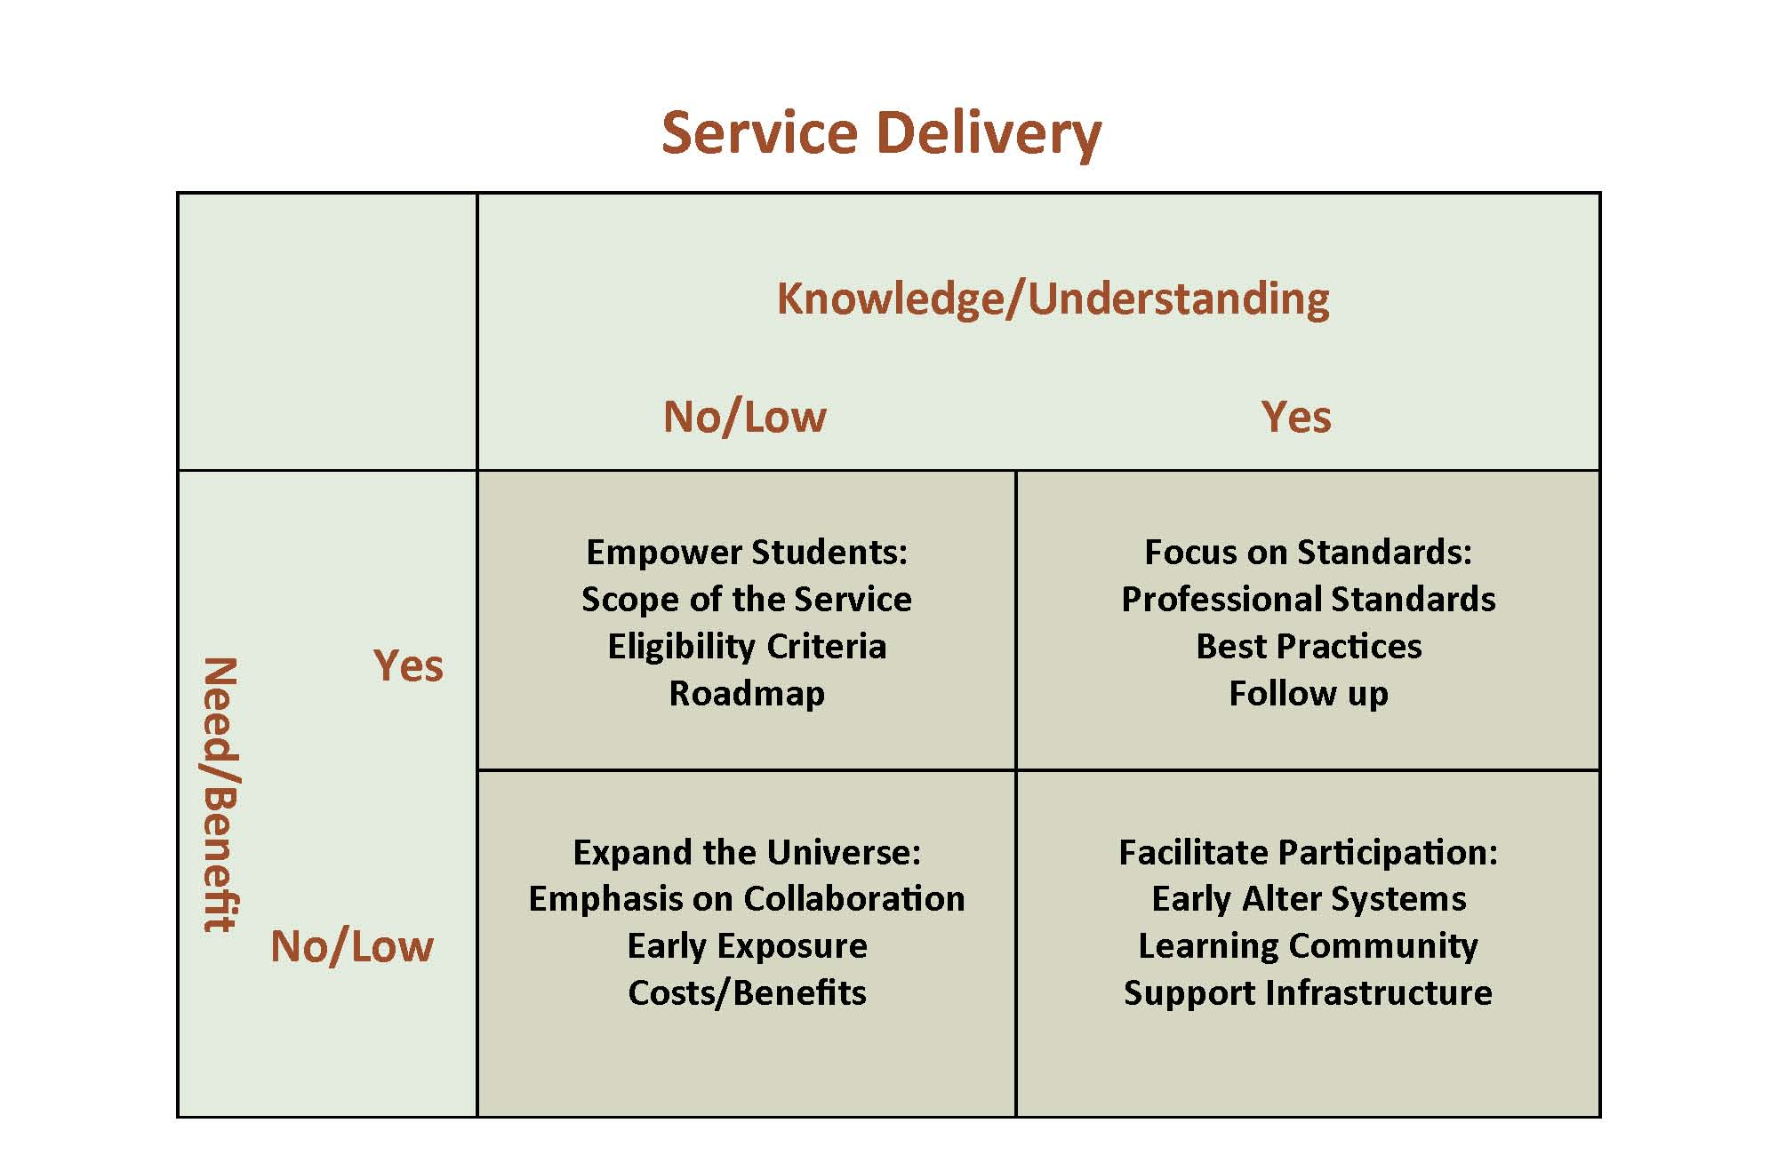
CUNY Assessment
Council
Notes:
Mosen’s slide
Different thing done “to with or for” students/clients in different boxes
Idea may be to move them all into Yes/Yes box
However, sometimes it may be that No/low and No/low box is not worth moving from a cost/benefit standpoint.
Yes for need but no/low for understanding may benefit from some look at alignment of purpose between your perception and student’s. (Content/Conceptual analysis)
Hit button move to Slide 8

Slide 7
Logic Model: A Simple Form
INPUTS
OUTPUTS
OUTCOMES
Program investments
Activities
Participation
Short
Medium
Long-term
What we invest
What we do
Who we reach
What results
CUNY Assessment
Council
Notes:
7
From an Assessment perspective what information do you need to reduce your uncertainly about boxes and the causal assumptions of arrows
Evaluation/Assessment is often reading right to left.

Slide 8
Some Techniques
Logic Models for planning and alignment
Surveys – both for process, student satisfaction, and indirect learning assessment.
Content Analysis
Grades – Distributions etc.
Rubrics
Observations scored by a criteria
Institutional data
Test scores
CUNY Assessment
Council
Notes:
We have resources, workshops and people on all these.
See slide before. (logic Models)
Do them right ask things you can change. (Sam M., CSI and Ray Galinski from Lehman)
Content Analysis (Diane Phillips) is great for alignment (Common Reading, and for understanding in combination (Below on probation)
Obvious in some ways for tutoring what grades to they get but less good for specific skills.
Rubrics, yours and others, (CATW) etc,
Also a rubric Categories
Punctual
Courteous
Use of Tools
Accuracy/Intake
Knowledge Level
Gave Accurate Information
Team Work
Ranges of Measurement
1= Novice
2= In Progress
3= Competent
4= Proficient
5= Accomplished
6= Exemplary
Institutional Data: Completion and retention correlated with intervention
Test Scores: Admissions tests remedial etc.

Slide 9
Some Resources
A Road Map for Improvement of Student Learning and Support Services Through Assessment by James O. Nichols and Karen W. Nichols, (NY: Agathon Press, 2005)
Logic Modeling Methods in Program Evaluation by Joy A. Frechtling, (SF: Jossey-Bass, 2007)
CUNY Assessment Council

