Slide 1
Travel & Expense Workshop
The Office of Institutional and
Academic Programs
1160 Boylan Hall
718.951.5102

Slide 2
Topics
What is ‘Travel & Expense’?
Travel Authorization Workflow
Chartfields
Budget Query
Create and Submit Travel Authorization
Travel Authorization Approvals
Expense Report Workflow
Create and Submit Expense Report
Expense Report Approvals

Slide 3
What is Travel & Expense?
The CUNYfirst Travel and Expense Center is a self-service module that allows end users to submit travel authorizations and expense reports for reimbursement.

Slide 5
Requesting Travel Permission
Proxy/Expense User:
Check the budget
Create and Submit a travel authorization
Supervisor/Approver:
Review and approve travel authorization

Slide 6
Travel and Expense Checklist
Check Budget
Create and Submit Travel Authorization
Approvals
Create and Submit Expense Report
Approvals

Slide 7
Chartfields
Most departments have a Tax Levy budget.
Each Tax Levy budget is represented by a combination of numbers called ‘chartfields’
Your chartfields can be found by using the Chartfield Crosswalk.
Every Expense User user has a default set of chartfields, which can be modified as necessary.

Slide 8
Chartfield Crosswalk
Navigate to: Brooklyn.cuny.edu/budget > Resources > Instructions and Guidelines
> CUNYfirst Chartfield Crosswalk

Slide 9
Budget Query
Navigate to: home.cunyfirst.cuny.edu > Login > Financials Supply Chain > Reporting Tools > Query > Query Viewer

Slide 10
Travel and Expense Checklist
✔
Check Budget
Create and Submit Travel Authorization
Approvals
Create and Submit Expense Report
Approvals

Slide 11
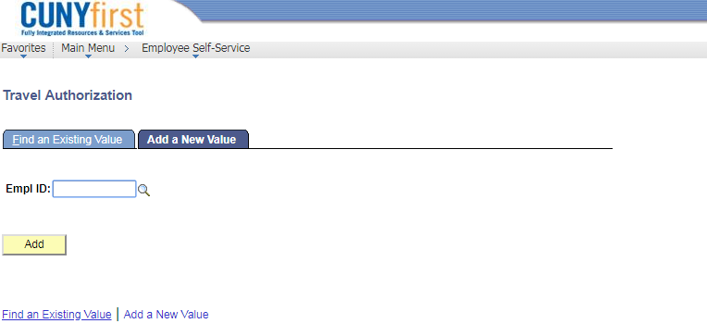
Create and Submit Travel Authorization
Navigate to: home.cunyfirst.cuny.edu > Login > Financials Supply Chain > Employee Self-Service > Travel and Expense Center > Travel Authorization > Create

Slide 12
Travel and Expense Checklist
✔
Check Budget
Create and Submit Travel Authorization
Approvals
Create and Submit Expense Report
Approvals
✔

Slide 13
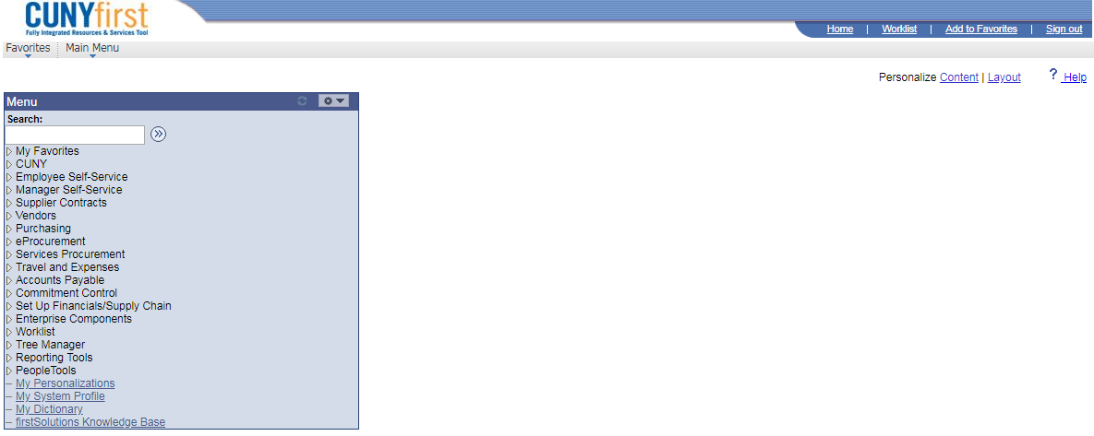
Approvals
Navigate to: home.cunyfirst.cuny.edu > Login > Financials Supply Chain > Worklist

Slide 14
Approvals

Slide 15
Approvals

Slide 16
Approvals

Slide 17
Approvals

Slide 18
Approvals / Send Back

Slide 19
Approvals / Send Back

Slide 20
Approvals / Send Back

Slide 21
Travel and Expense Checklist
✔
Check Budget
Create and Submit Travel Authorization
Approvals
Create and Submit Expense Report
Approvals
✔
✔

Slide 22
Requesting Reimbursement
Proxy/Expense User:
Check the budget
Link travel authorization (if necessary) and create and submit an expense report
Supervisor:
Review and approve expense report
Accounts Payable:
Review and approve expense report

Slide 23
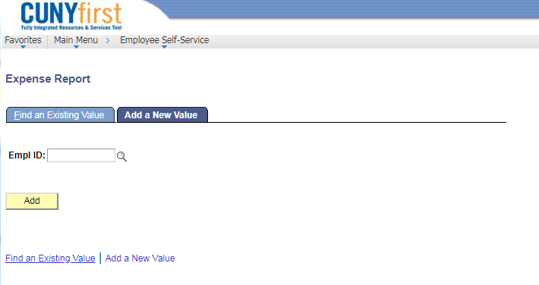
Create and Submit Expense Report
Navigate to: home.cunyfirst.cuny.edu > Login > Financials Supply Chain > Employee Self-Service > Travel and Expense Center > Expense Report > Create

Slide 24
My Wallet
Travel Card transactions from Citibank are loaded into the Travel and Expense module of CUNYfirst through a function called ‘My Wallet’.
Travel card reconciliation must be completed within 14 calendar days after completion of the trip. (CUNYfirst expense report must be submitted listing Travel Card charges from My Wallet and any employee paid expenses)

Slide 25
Expense Report - Travel Card Transactions

Slide 26
Expense Report - Travel Card Transactions

Slide 27
Expense Report - Travel Card Transactions

Slide 28
Expense Report - Travel Card Transactions

Slide 29
Expense Report - Travel Card Transactions

Slide 30
Travel and Expense Checklist
✔
Check Budget
Create and Submit Travel Authorization
Approvals
Create and Submit Expense Report
Approvals
✔
✔
✔

Slide 31
Approvals
Navigate to: home.cunyfirst.cuny.edu > Login > Financials Supply Chain > Worklist

Slide 32
Travel and Expense Checklist
✔
Check Budget
Create and Submit Travel Authorization
Approvals
Create and Submit Expense Report
Approvals
✔
✔
✔
✔

Slide 33
Contacts
Office of Accounts Payable: ext 5421
Gulnoza Shakirova (gshakirova@brooklyn.cuny.edu)
Niky Wu (niky.wu@brooklyn.cuny.edu)
Office of Budget: ext 5220
Michael Lanza (mlanza@brooklyn.cuny.edu)
Tax Levy Budget Reports (tlbr@brooklyn.cuny.edu)
CUNYfirst Travel Authorizations / Expense Reports: ext 5116
David Gretah (dgretah@brooklyn.cuny.edu)
Trainings: ext 1550 / 5102
Patrick O’Connor (patricko@brooklyn.cuny.edu)

Slide 34
Register for our other classes!
Brooklyn College Knowledge
Introduction to Purchasing
eProcurement Workshop 1: How to Buy (Requisitions)
eProcurement Workshop 2: How to Pay (Receipts)
Introduction to Travel & Expense

