Slide 1
Brooklyn College Facilities Town Hall
Alan Gilbert, SVP Finance and Administration
January 2019

Slide 2
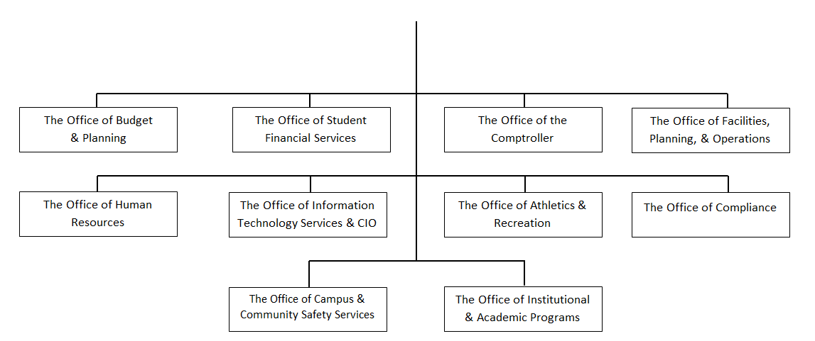
The Office of Finance and Administration
Alan Gilbert
Senior Vice President of Finance & Administration Appointed February 2018

Slide 3
Agenda
1. Progress Update
2. Survey Results
3. Next Steps
4. Discussion: Q & A
Notes:
1. The Office of Finance and Administration
Office Mission Statement/Structure
2. Presentation
Prioritizing Campus Needs
Plans for Continued Success
3. Q & A

Slide 4
Lecture Halls
Spring 2018
3139 Boylan Hall
Fall 2018
148 Ingersoll Extension
320 Whitehead Hall
Spring 2019
222 Whitehead Hall
3129 Boylan Hall

Slide 5
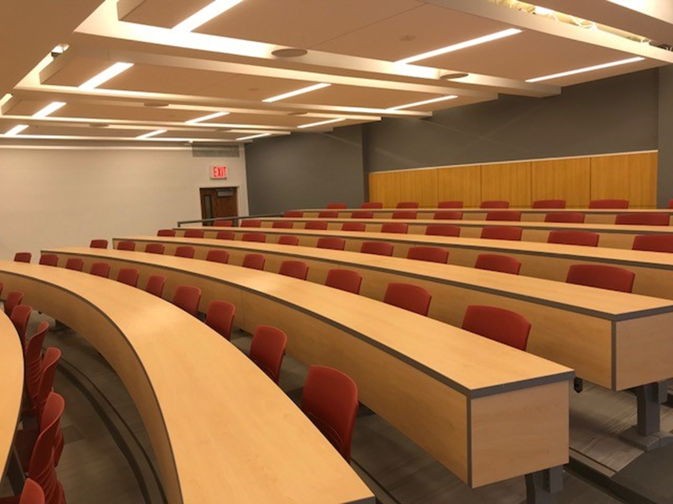
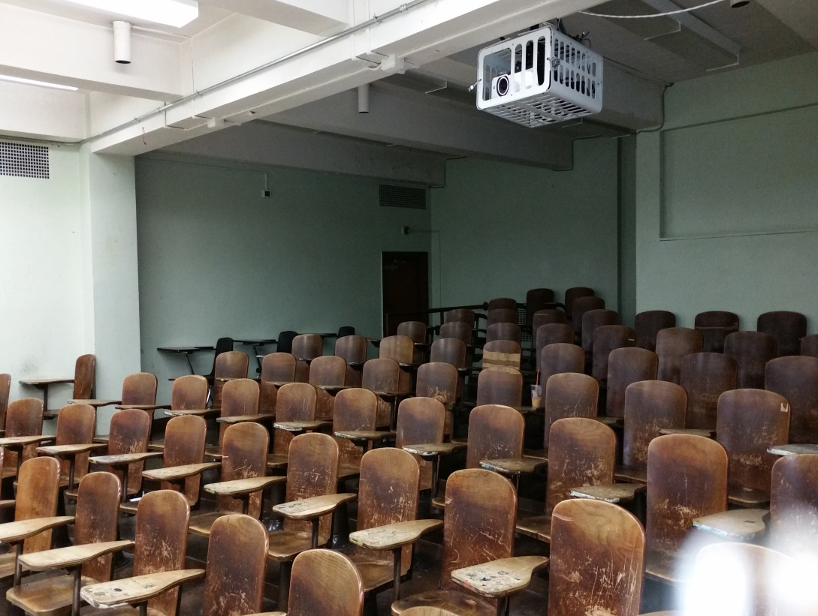
Lecture Hall 3139, Boylan Hall

Slide 6
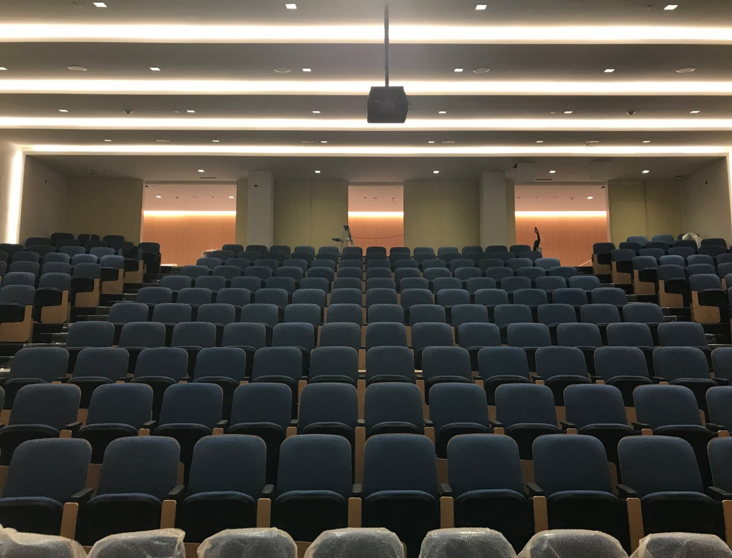
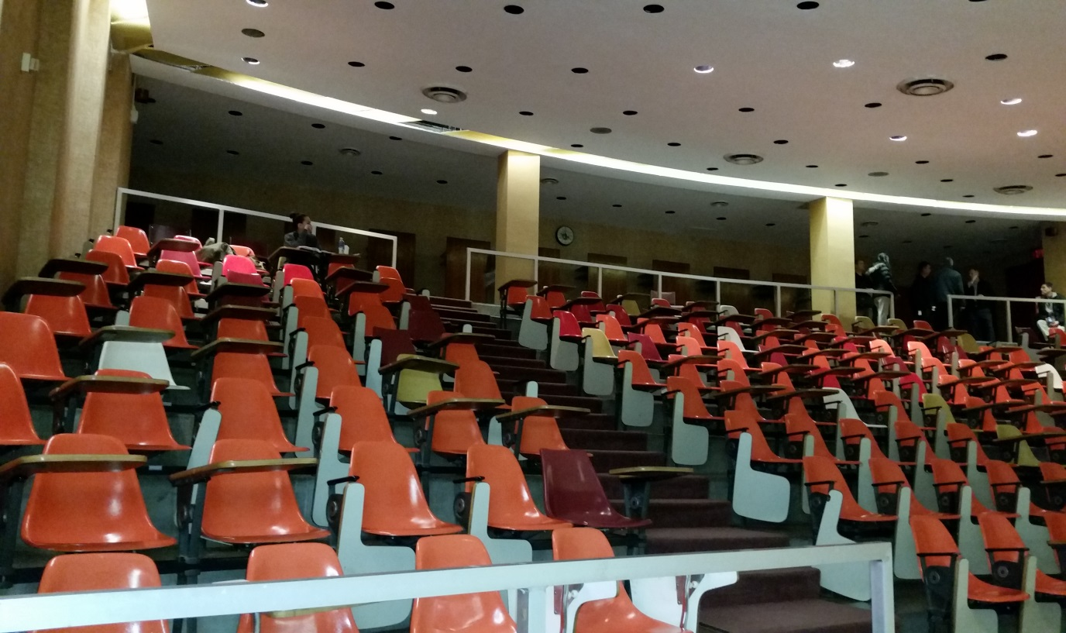
Lecture Hall 148, Ingersoll Extension

Slide 7
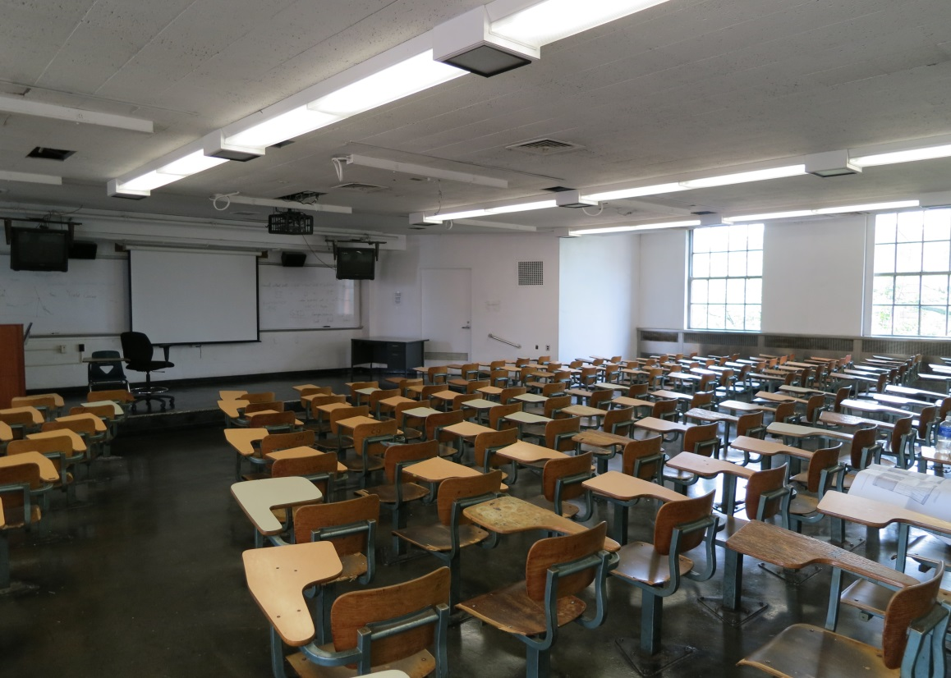
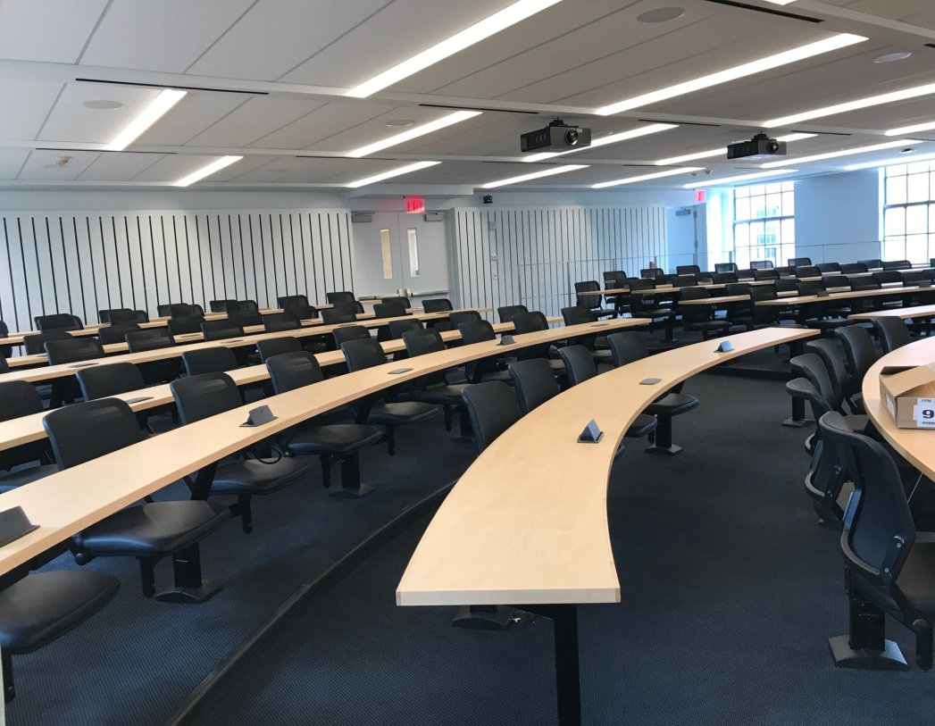
Lecture Hall 320, Whitehead Hall

Slide 8
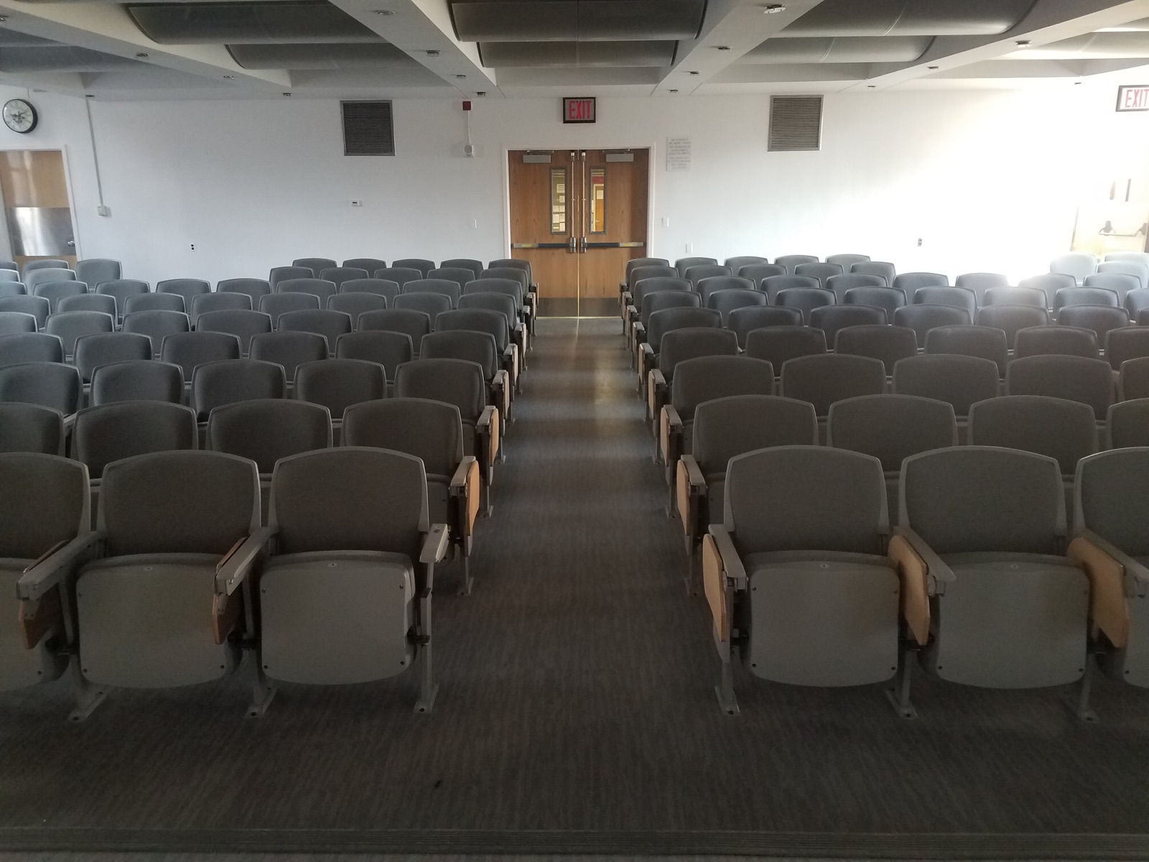
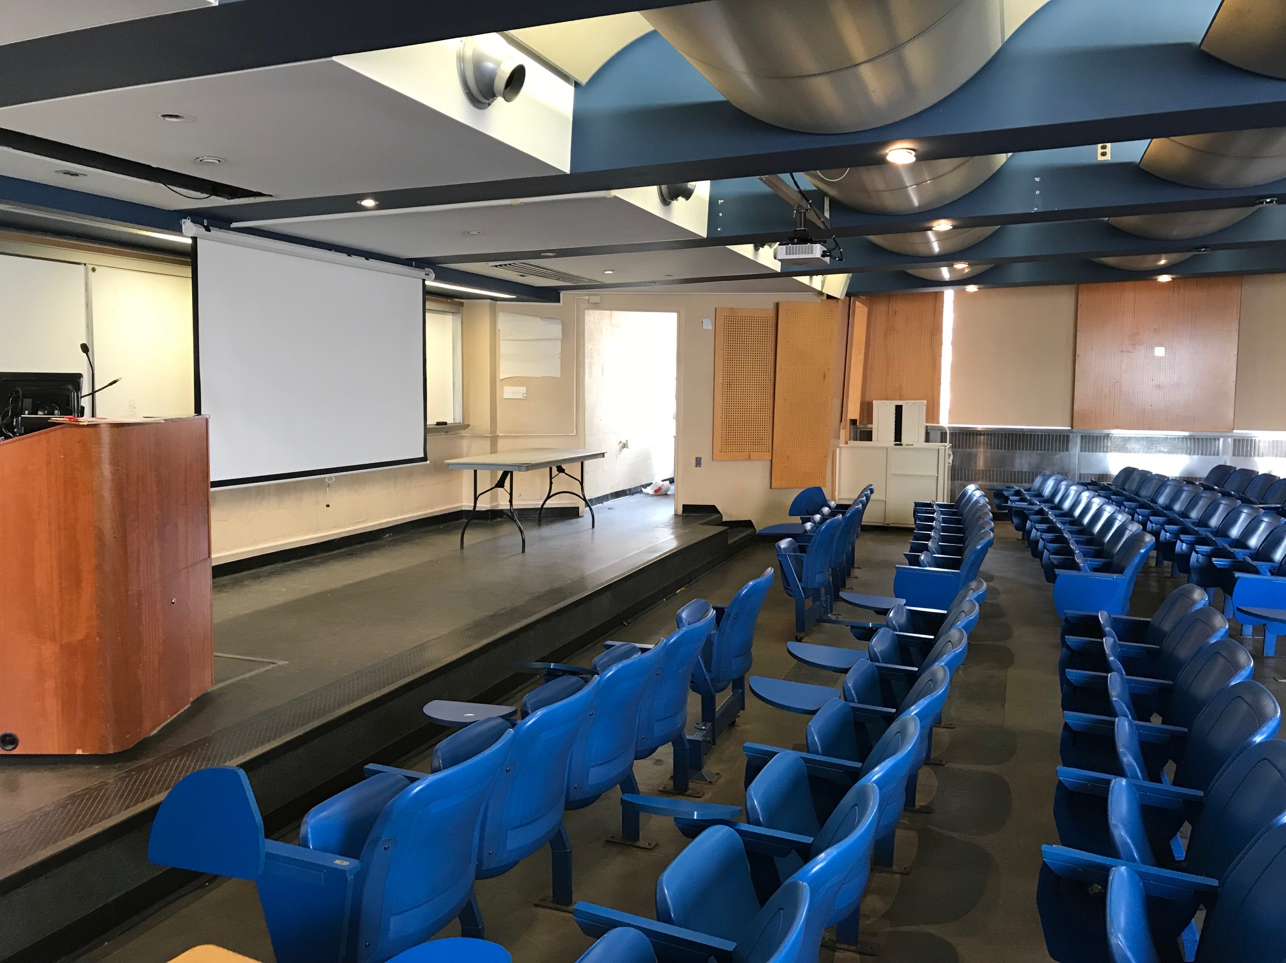
Lecture Hall 222, Whitehead Hall

Slide 9
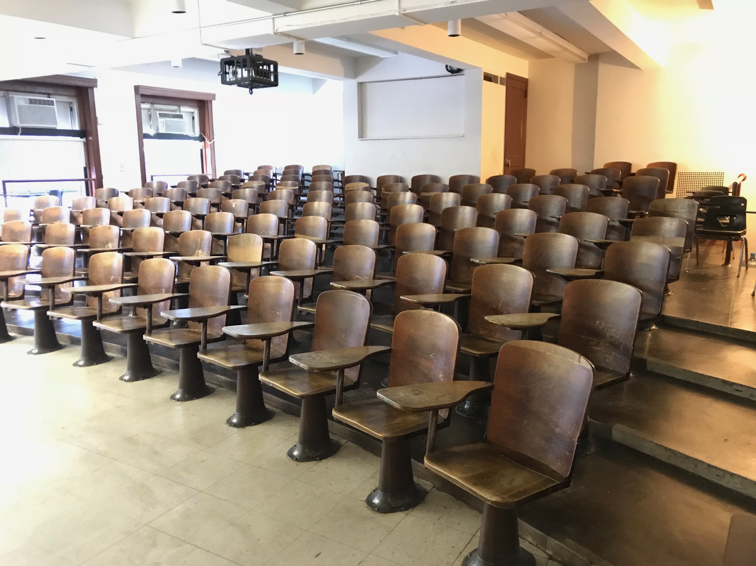
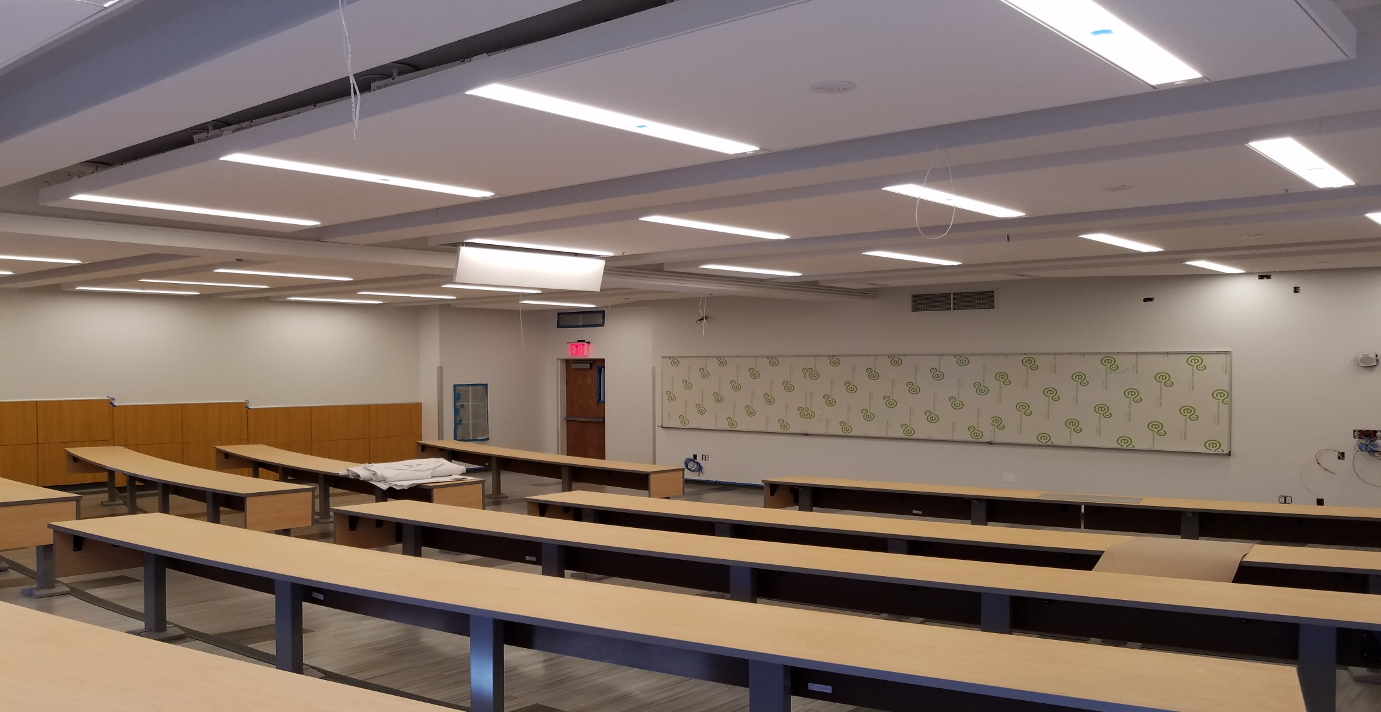
Lecture Hall 3129, Boylan Hall

Slide 10
Bathrooms
Spring 2018
Implemented 90-Day Challenge
1,690 fixtures assessed across 236 bathrooms
757 Issues identified and resolved
Conceptualized BC Fix-it
Fall 2018
Pilot Tested BC Fix-it
Winter 2019
Rolled out BC Fix-it
12 unresolved BC Fix-it issues as of January 10, 2019

Slide 11
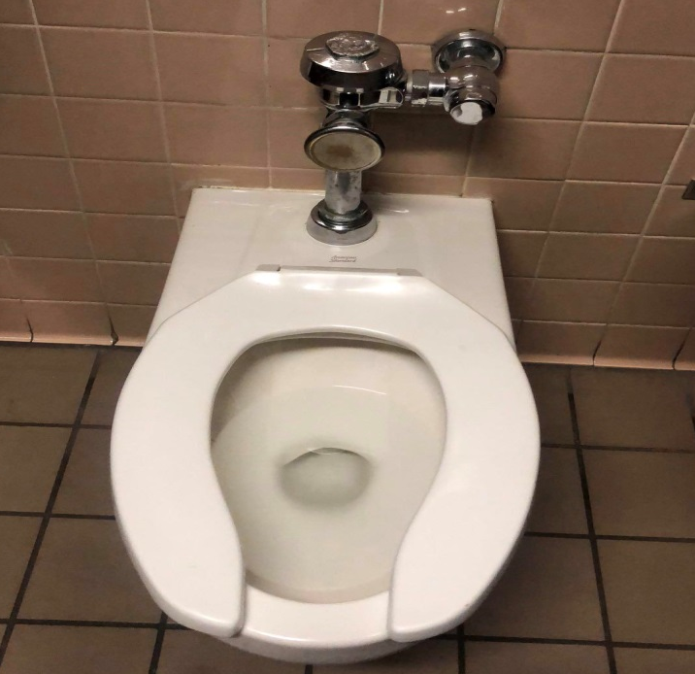
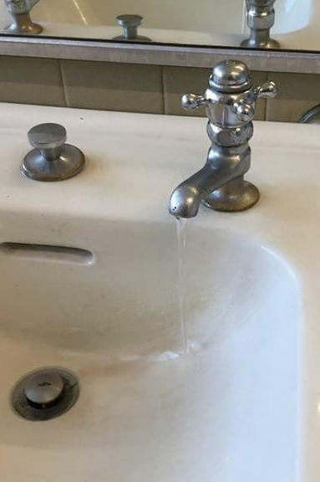
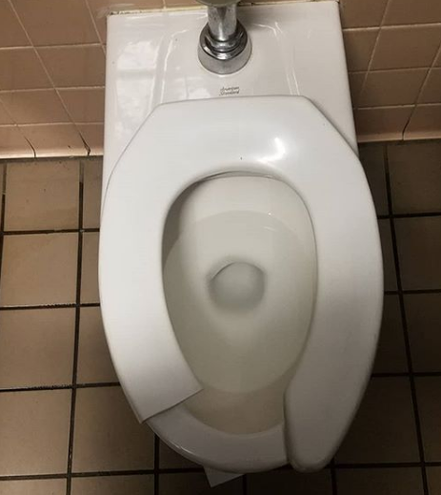
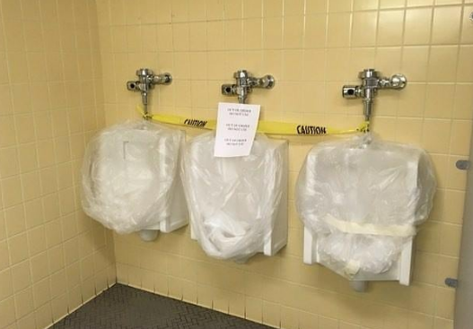
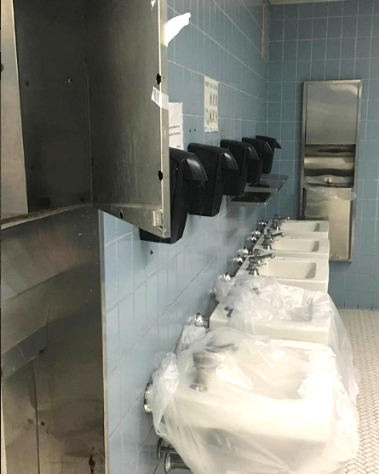
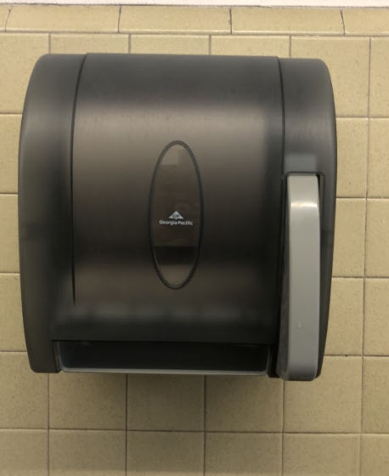
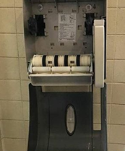
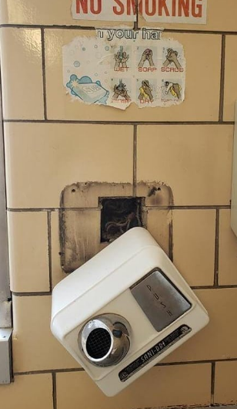

Slide 12
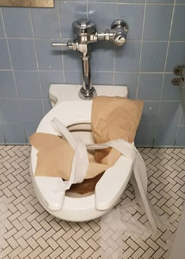
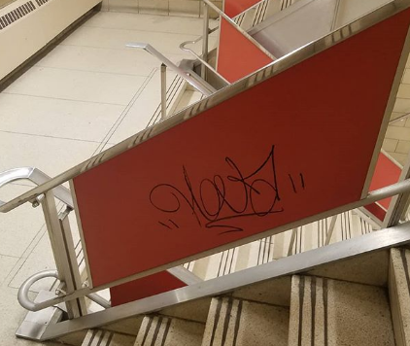
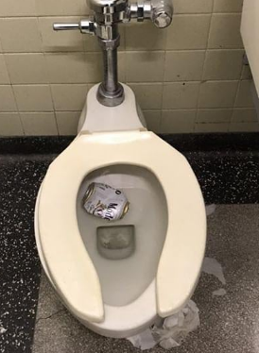
How you can help
Respect our shared spaces, as well as, one another
Prevent bathroom clogs
Every clog ≈ $200 in labor costs
Clean up after meals
Use trash cans, not floors
Report issues

Slide 13
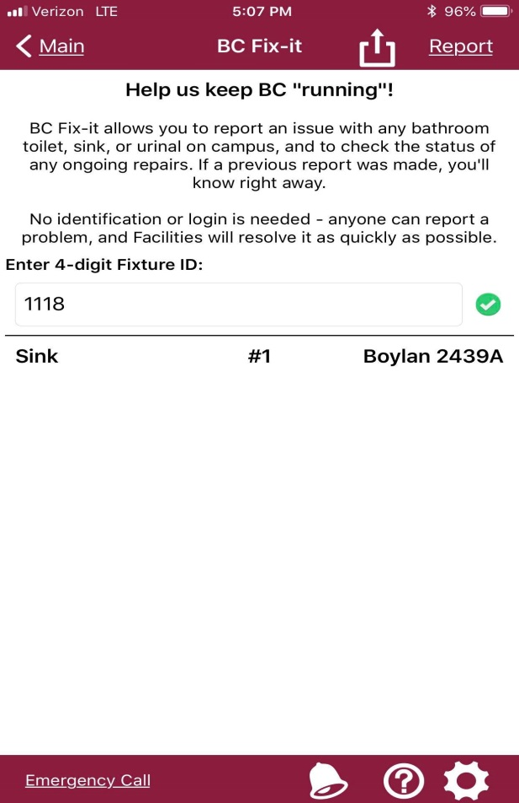
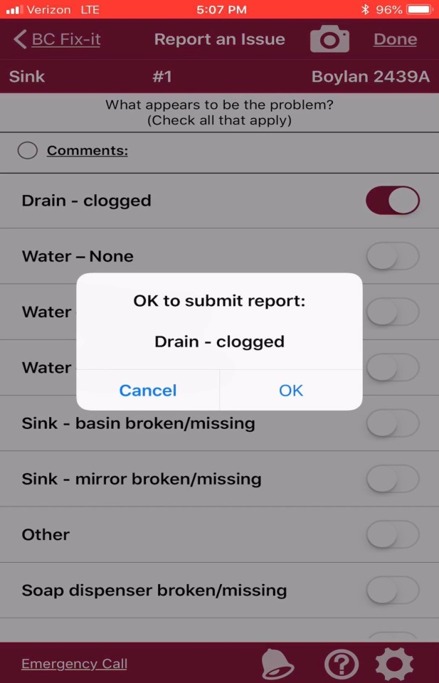
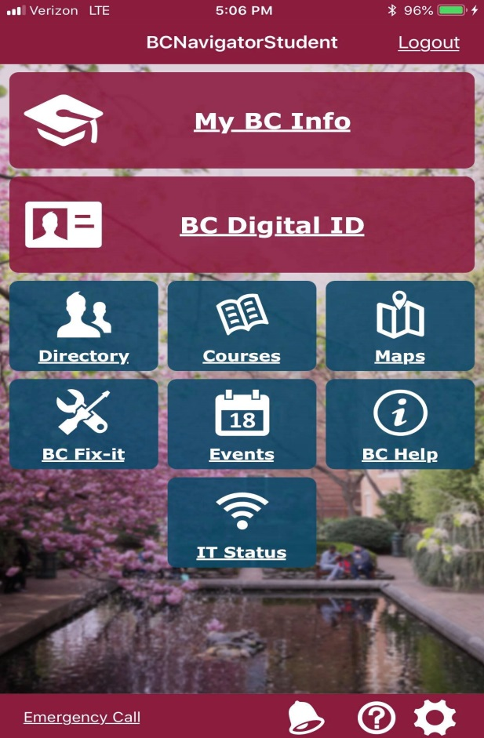
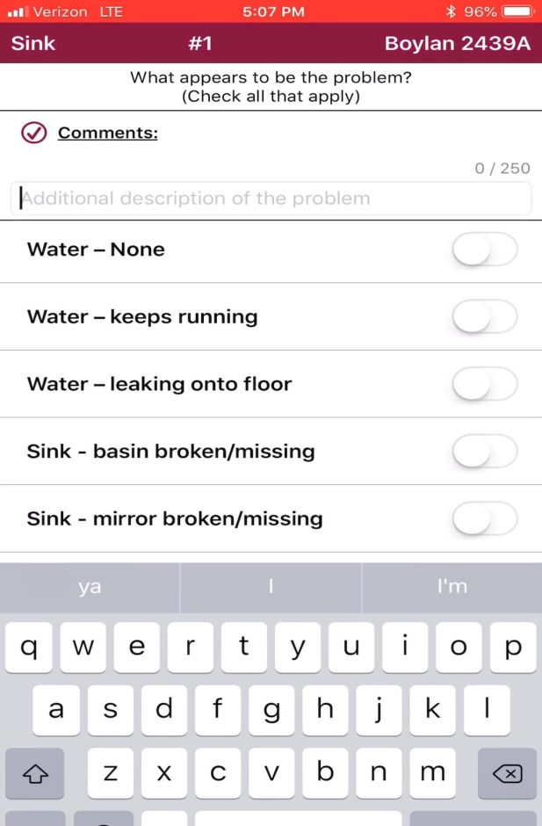

Slide 14
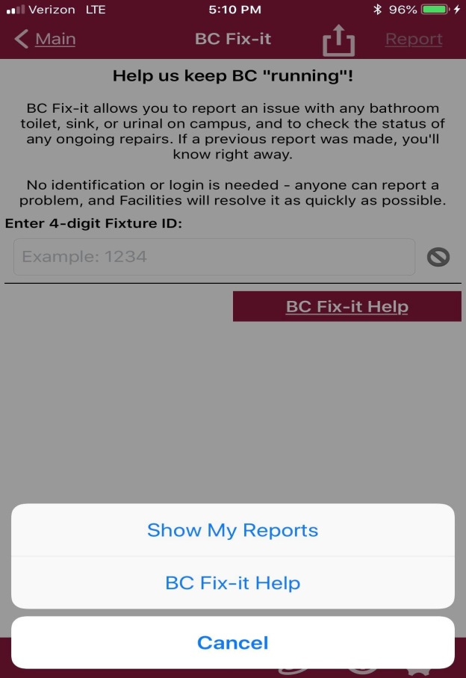
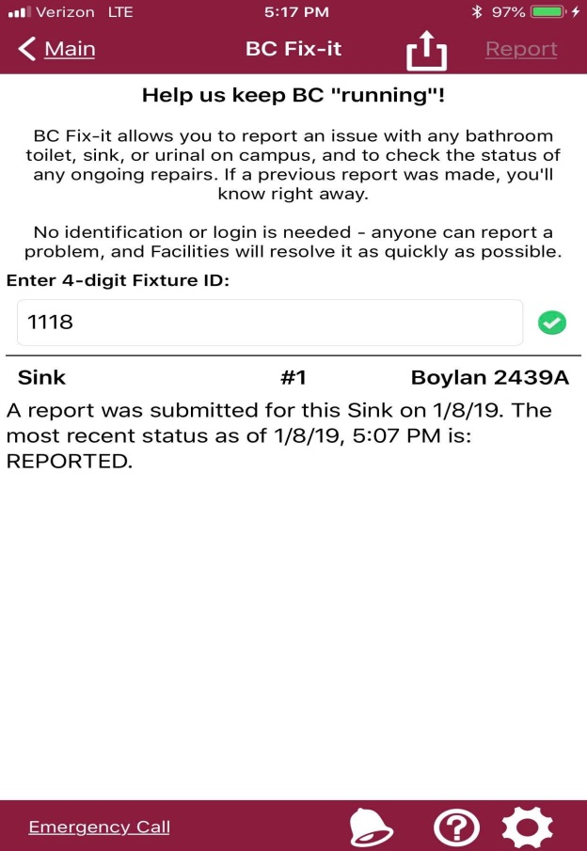
Check on the status of reports you submitted.
If a report has already been submitted for a tag ID, you will be unable to submit a new report.

Slide 15
Reporting Other Issues
Email BCFIX-IT@brooklyn.cuny.edu
Other facilities-related concerns
Restroom cleanliness
Holes in walls/ceilings
Graffiti

Slide 16
How you can help
Recycle
Close the windows when you leave

Slide 17
Facilities Survey
Survey results are used to assess progress and areas for improvement
Surveys conducted in Fall 2017 (for Middle States), Spring 2018, and Fall 2018
New initiatives will follow to generate improvements
Survey will be administered each semester

Slide 18
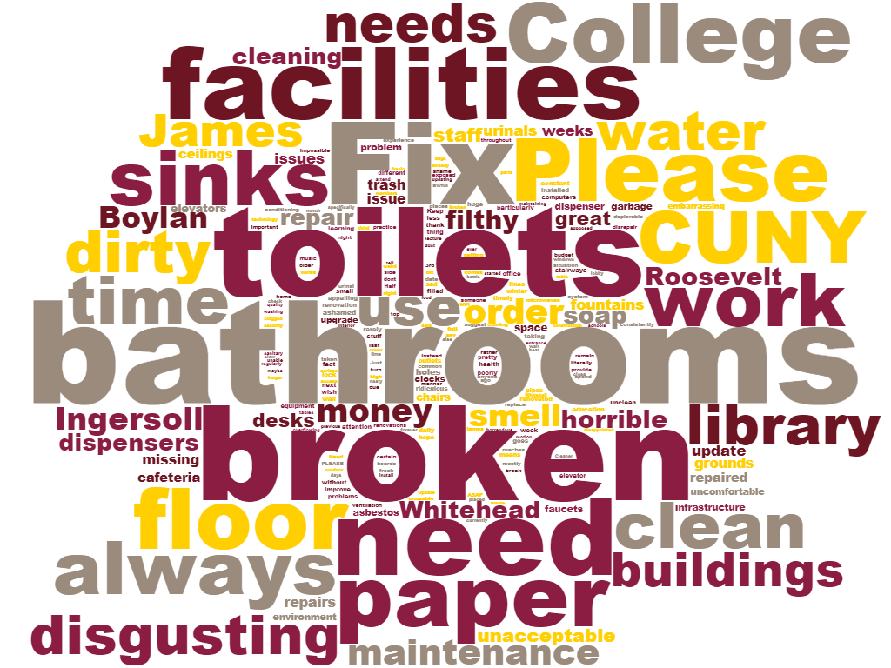
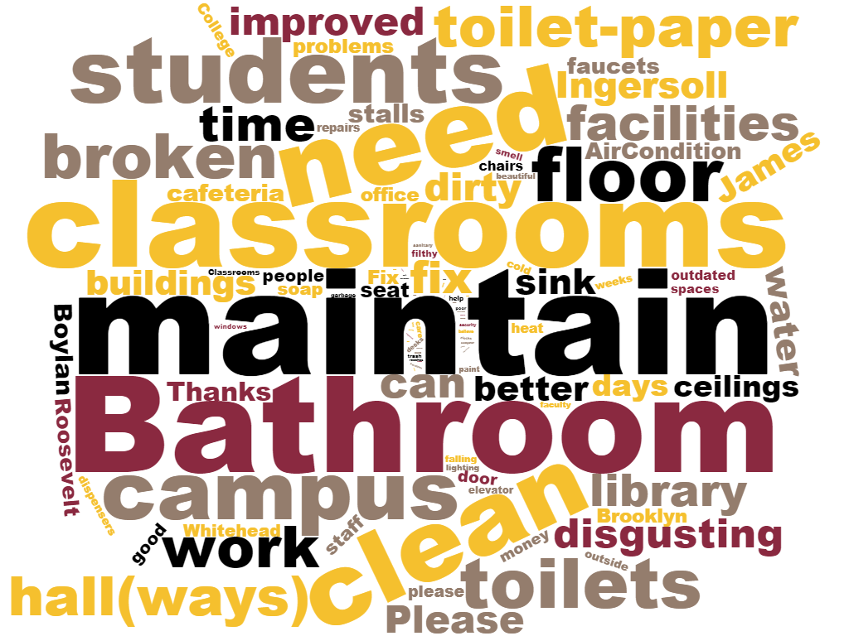
Spring 2018
Fall 2018

Slide 19
Discussion
Q & A

